Slide 1
User Management in Merchant Acquirer Portal
Context:
During discussion with Paul Baker on how KeyCloak has been used in Mojaloop, we came to know that Mojaloop Business Ops framework uses WSO2 as OIDC provider and also ORY for fine grained permissions. - https://github.com/mojaloop/business-operations-framework-docs/blob/main/docs/guide/SecurityBC.md
Currently Mojaloop core team is working on replacing WSO2 with KEYCLOAK but there is no definite timeline for this.
Way forward for Merchant Payments workstream
For current PI we have limited time so we are implementing a bespoke User/Role Management structure for the Merchant Acquirer portal for now. The UI front ends are being created for
  Role Management
  User Creation
Once Mojaloop Business operations framework has implemented KeyCloak then we will review it and adopt it.

Slide 2
Merchant Registry design
How Merchant Acquirer Portal and Merchant Registry interact with Mojaloop
Key Assumptions/Decisions
Tables/Database structure for Merchant Registry
API Interfaces exposed by Merchant registry
Flow diagram of Register Alias API

Slide 3
DFSP3
End-Points
MAP → DFSP1, DFSP2
DFSP3 → DFSP3
Merchant Acquirer
Portal
Registry
DFSP1, DFSP2
Using Merchant Acquirer Portal
POST /Authenticate
POST /RegisterAlias
POST /ChangeDFSP
3 scopes
Hub Operator
DFSP
Merchant
DFSP has 2 roles
Maker
Checker
GET /participants
ALS
DFSP 1
MOJALOOP
DFSP 2

Slide 4
Key Assumptions/Decisions
Merchant Registry is an Oracle it can be populated by any DFSP who may or may not be using Merchant Acquirer Portal
As Oracle, currently the Registry implement GET /parties interface
What will not be implemented right now
  PUT /parties interface
  Reason is that it assumes that Participant will create Alias and put in Oracle. Currently, we are only developing “CreateAlias” end-point which creates an Alias and links it to requesting DFSP also.
  Secondly, PUT /parties interface currently does not support extension information which we need to capture i.e. Merchant Identifier.

Slide 5
Tables for Registry
Table/Entity | Purpose | Columns | Notes
End_Point | List of all end-points | End Point ID Authentication Credential (password) Status (active/inactive) | This table is required to manage the credentials of entities that can call Registry
End_Point_DFSP | End-Point-DFSP mapping | End Point ID DFSP_ID (1 or many) | This table keeps record of which DFSP can request add/update from the given end-point
Registry | Alias/DFSP mapping | DFSP_ID Merchant_ID CheckOutCounter_ID PayInto_ID | Core Merchant registry table
History | For recording change of DFSP | Date/Time PayInto_ID Old_DFSP_ID New_DFSP_ID | History of changes of one PayInto_ID from one DFSP to another

Slide 6
API Interface
API Interface | Type | Purpose | Request | Response
/api/v1/authenticate | POST | Authenticate caller and issuer token | EndPointID AccessCredential | Header http/response Body AccessToken Expiry Time
/api/v1/RegisterAlias | POST | RegisterAlias | Header Access Token Body DFSPID MerchantID CheckOutCounterID | Header http/response Body Result_Code (ENUM) Result_Description PayINTOID

Slide 7
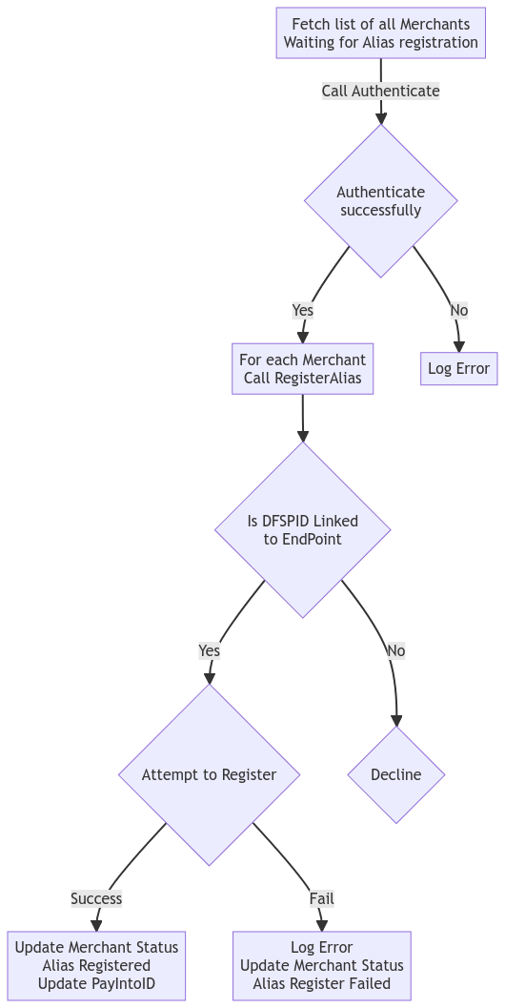
Merchant Alias registration Job
Call Authenticate endpoint
Get Access Token
For each Merchant where Alias not registered
  Call RegisterAlias API
  If result is success, its registered, get the PayInto_ID, store it and Update status
  If result is not success, its not registered, Update the status with “Alias Register Failed”

Slide 8
Source for Flow diagram (mermaid.live)
flowchart TD
A[Fetch list of all Merchants<br/>Waiting for Alias registration] --> |Call Authenticate| C{Authenticate<br/>successfully}
C -->|Yes| D[For each Merchant<br/>Call RegisterAlias]
C -->|No| E[Log Error]
D --> I{Is DFSPID Linked<br/> to EndPoint}
I --> |Yes| F{Attempt to Register}
I --> |No | J{Decline}
F -->|Success| G[Update Merchant Status<br/>Alias Registered<br/>Update PayIntoID]
F -->|Fail| H[Log Error<br/>Update Merchant Status<br/>Alias Register Failed]

